Slide 3
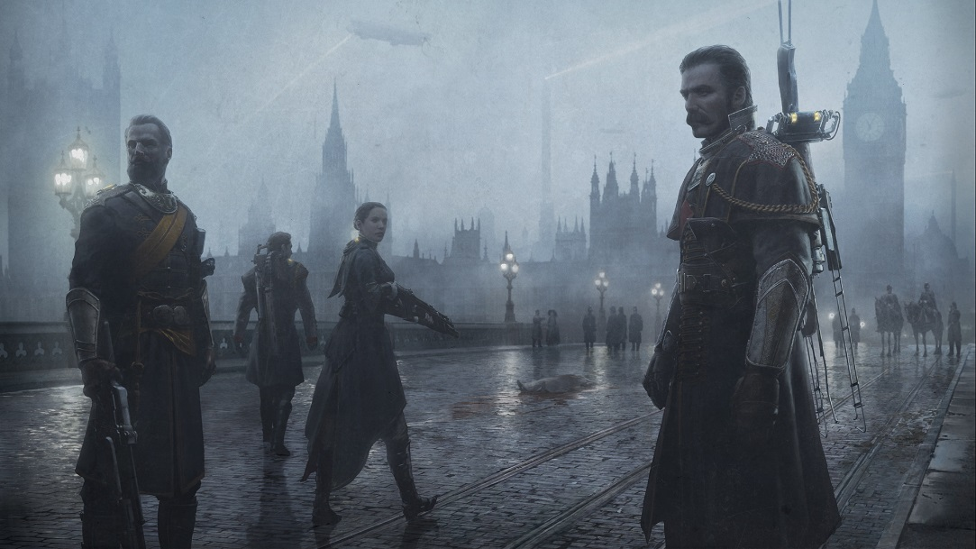
About Our Project
Brand-new IP
Alternate history 19th-century London
PS4 Exclusive
~100 developers
Notes:
Brand-new IP being developed in-house (our first!)
When I started about 4 years ago we had about 38 people, now we have over 100.

Slide 4
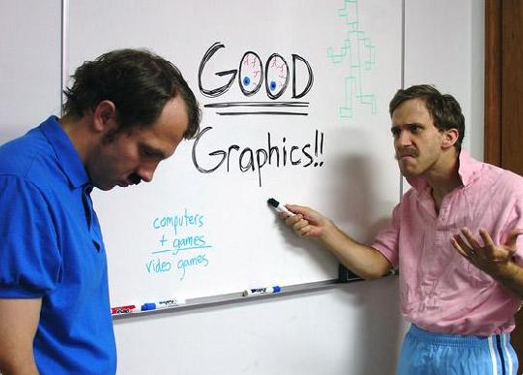
About Our Project
Work began in early 2011
Originally just 2 graphics programmers
Now we have 5!

Slide 5
Engine Overview
Latest version of our in-house engine
Windows(DX11) and PS4, but heavily geared towards PS4
Fine-grained task scheduling
Low-overhead, multithreaded cmd buffer generation
PS4 Secret Sauce™
Physically based rendering from the start
Notes:
Windows build is primarily for tools, and for our renderer embedded inside of Maya
Can’t talk about the PS4-specific things yet, it will have to wait for Devcon.
Physically based rendering isn’t just a checkbox for us, it’s a philosophy that we try to adhere to for all aspects of rendering. We always try to reason about the physical phenomena that drives the real-world scenarios that we’re trying to replicate.

Slide 6
Engine Overview
Core tools framework uses C++ and Qt
Built on common UI core
Can be embedded in Maya
Custom build pipeline built in C++
Major engineering effort
Heavily multithreaded
Processed assets cached on local servers
Notes:
Our build system is a major component of our tech, and it’s unfortunate that people don’t talk about them more. One our biggest challenges moving to PS4 was handing the massive amounts of data required for our assets, which grew by leaps and bounds compared to previous titles. It’s important that we have a heavily multithreaded build system with a distributed caching system, otherwise our studio would grind to a halt. We also have a brand-new set of 25 build machines, which crank away on our levels to make sure that the cache is always populated.

Slide 7
Engine Overview
Renderer embedded in Maya
Uses DX11 Viewport 2.0 override (Maya 2014)
Render using their device instead of our own
Tell Maya which UI to draw
Materials/particles/lens flares/etc. can be live edited inside of Maya
Serves as primary level editor
Notes:
Having the renderer inside of Maya is great for artists, but can be an engineering burden. Sometimes it almost feels like it’s a 3rd platform that we have to support. The Viewport 2.0 setup in 2014 is pretty nice, since we can render using DX11 and tell Maya exactly which UI elements we want drawn. This lets us integrate our render with things like the wireframe overlay for showing selected meshes.

Slide 8
Memory
2 GB texture budget
128 MiB sound budget
700 MiB level geometry
600 MiB character textures
250 MiB global textures (FX, UI, light maps, etc..)
Even characters have lightmap data
700 MiB animation
Notes:
The texture budget is shared between environment, characters, and props. It’s crazy that we run out of 2GB, but we do frequently.

Slide 9
Memory
Environmental art is mapped at 512 pixels per unit
Standard environment tiling texture is 1024x1024
Notes:
1 unit = 1 meter

Slide 10
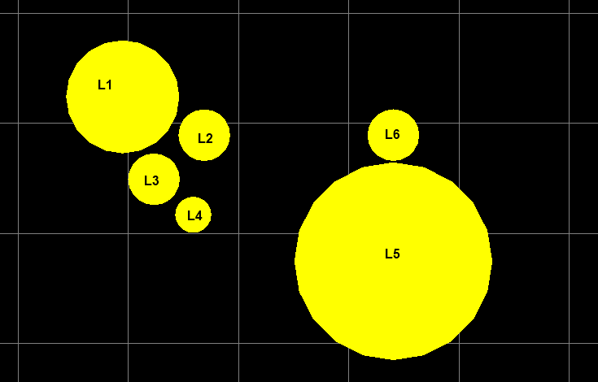
Lighting Pipeline
Tiled forward lighting (AKA Forward+)
Depth prepass
CS bins lights per tile
Two depth partitions
Punctual light sources (no area lights…yet!)
Notes:
At one point or another our engine has gone through just about every version of deferred rendering that’s out there. We went from light prepass, to traditional deferred rendering with a fat G-Buffer, and then tiled deferred shading using a compute shader. In 2012 or so we ended up trying tiled forward rendering, after it got a lot of popularity due to AMD’s Forward+ demo. At the time we had around 5 or 6 G-Buffers in order to store all of the material parameters needed for shading our various BRDF’s, and switching to Forward allowed us to more easily experiment with our lighting models without having to constantly re-arrange our G-Buffer. It also has some performance-friendly characteristics on the PS4 GPU, especially when MSAA is used. And we love MSAA! We still haven’t come up with a real-time area light model that we’re happy with, so unfortunately we don’t have dynamic area lights yet.

Slide 11
Lighting Pipeline
Transparents fully lit with diffuse + specular
Separate depth prepass + depth buffer for transparents
Transparent light list generated per-tile
TileMinDepth = TileMin(transparentDepth)
TileMaxDepth = TileMax(opaqueDepth)
Also support per-vertex lighting for particles
Notes:
You can handle transparents with tiled forward by generating another set of per-tile lists. The simple way to do it would be to cull all lights that intersect with the tile frustum starting at the near clip plane, and extending to the max tile depth. However you can generate more optimal light lists if you generate a “transparent” depth buffer containing the min transparent depth per pixel. One catch is that with this you don’t want to just use the min and max tile depth of your transparent depth, because you could exclude depth ranges where one transparent is fully covered by another closer transparent surface. So instead you want to use your transparent depth buffer only for the min tile depth, and your normal opaque depth buffer to compute the tile max depth.
For particles we also support per-vertex lighting. For larger CPU-simulated “billboard” particles we light at each vertex of the quad, and support CPU-side tessellation to increase the lighting fidelity. For smaller point-sprite particles rendered on the GPU, we just light the single center vertex of each particle.

Slide 12
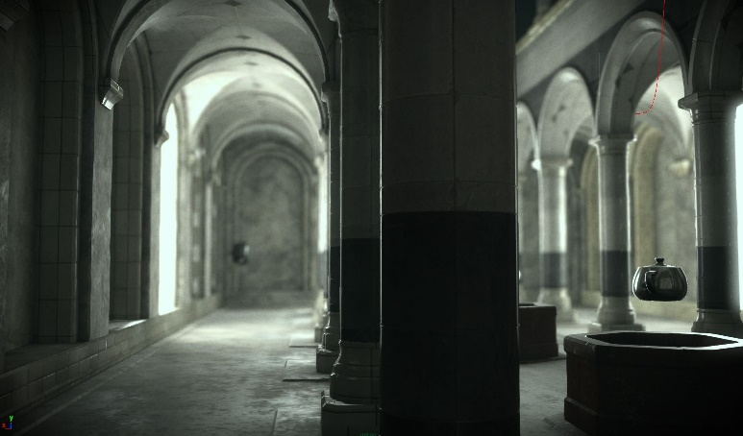
Lighting Pipeline
Lightmaps for static geo
Baked on GPU farm using Optix
H-basis for directional variation
SH probes for dynamics
3rd-order (9 coefficients)
Pre-convolved specular probes
Cubemaps rendered in-engine, convolved in a compute shader
Notes:
Lightmaps have indirect from punctual lights + direct/indirect lighting from sky and area lights. We bake them using Optix on a linux bake farm loaded with GTX 780’s.
Using H4 as the basis, which is basically spherical harmonics constrained to the upper hemisphere instead of being defined on the whole sphere. We do it to get per-pixel directional variation from normal maps.
The baked specular is pretty standard for recent games. Artists hand-place probes throughout the level, then inside of maya we render the scene from the POV of each probe and save to a cubemap. Then we pre-integrate our primary specular BRDF for each texel of the cubemap, assuming that V = N and using a different roughness for each mip level. Then at runtime we look up into the cubemap using the reflection vector, and apply Fresnel after the fact. Note that you really want Fresnel + your BRDF integrated into the entire lighting environment using the current viewing angle, but with a cubemap you don’t have enough dimensionality so you have to approximate. We do this by applying a simple curve that we fit based on roughness + viewing angle, otherwise the glancing angles will generally be too bright. See Black Ops 2 or Unreal Engine 4 talks from SIGGRAPH 2013 for more info.

Slide 13
Lighting Pipeline
Notes:
These are some test scenes that we were using to standardize lighting and exposure values at the beginning of the project. This was an important process, because we wanted to make sure that we had a proper HDR workflow that wasn’t reliant on per-scene tweaks to materials. In particular it was important for emissive surfaces like light bulbs, which we wanted to look convincing in both dark and bright areas of the game. The screenshots were taken using our renderer embedded inside of Maya. The screenshots are somewhat old, but they’re still do a decent job of showing of our GI pipeline.

Slide 14
Lighting Pipeline

Slide 15
Lighting Pipeline

Slide 16
Lighting Pipeline

Slide 17
Lighting Pipeline
Notes:
H-basis gives you nice bump fidelity, which helps you have interesting lighting variation even when you don’t have direct lighting from dynamic light sources.

Slide 18
Ambient Occlusion
Directional AO maps (H-basis) baked for characters and static geo
Static geo only uses it to occlude specular from probes
Dynamic geo applies AO to diffuse from SH probes
Notes:
Using specular from cubemaps captured at probe locations is problematic, because the samples are so sparse. Thus you end up with visibility issues, where lighting might “leak” through geometry that should have occluded it. To help work around this issue we pre-bake directional occlusion into lightmaps. We use the same Optix ray-tracing pipeline, except instead of integrating incoming radiance we integrate per-ray visibility onto H-basis. Then we look this up at runtime in the cubemap direction, and use the result to attenuate the specular.

Slide 19
Without Reflection Occlusion
Notes:
No reflection occlusion. Notice specular on the edges of the inner machinery.
Note that this screenshot is from a very old build of the engine, and was taken using our Maya renderer.

Slide 20
With Reflection Occlusion
Notes:
With occlusion. Inner edges now look better.

Slide 21
Reflection Occlusion Visualization
Notes:
This is the occlusion factor visualized. If you were to rotate the camera, you would see the occlusion changing since it’s view-dependent. This helps prevent over-occluding the inner parts of the mesh.
Ignore the occlusion on the walls behind the gun, it wasn’t baked properly.

Slide 22
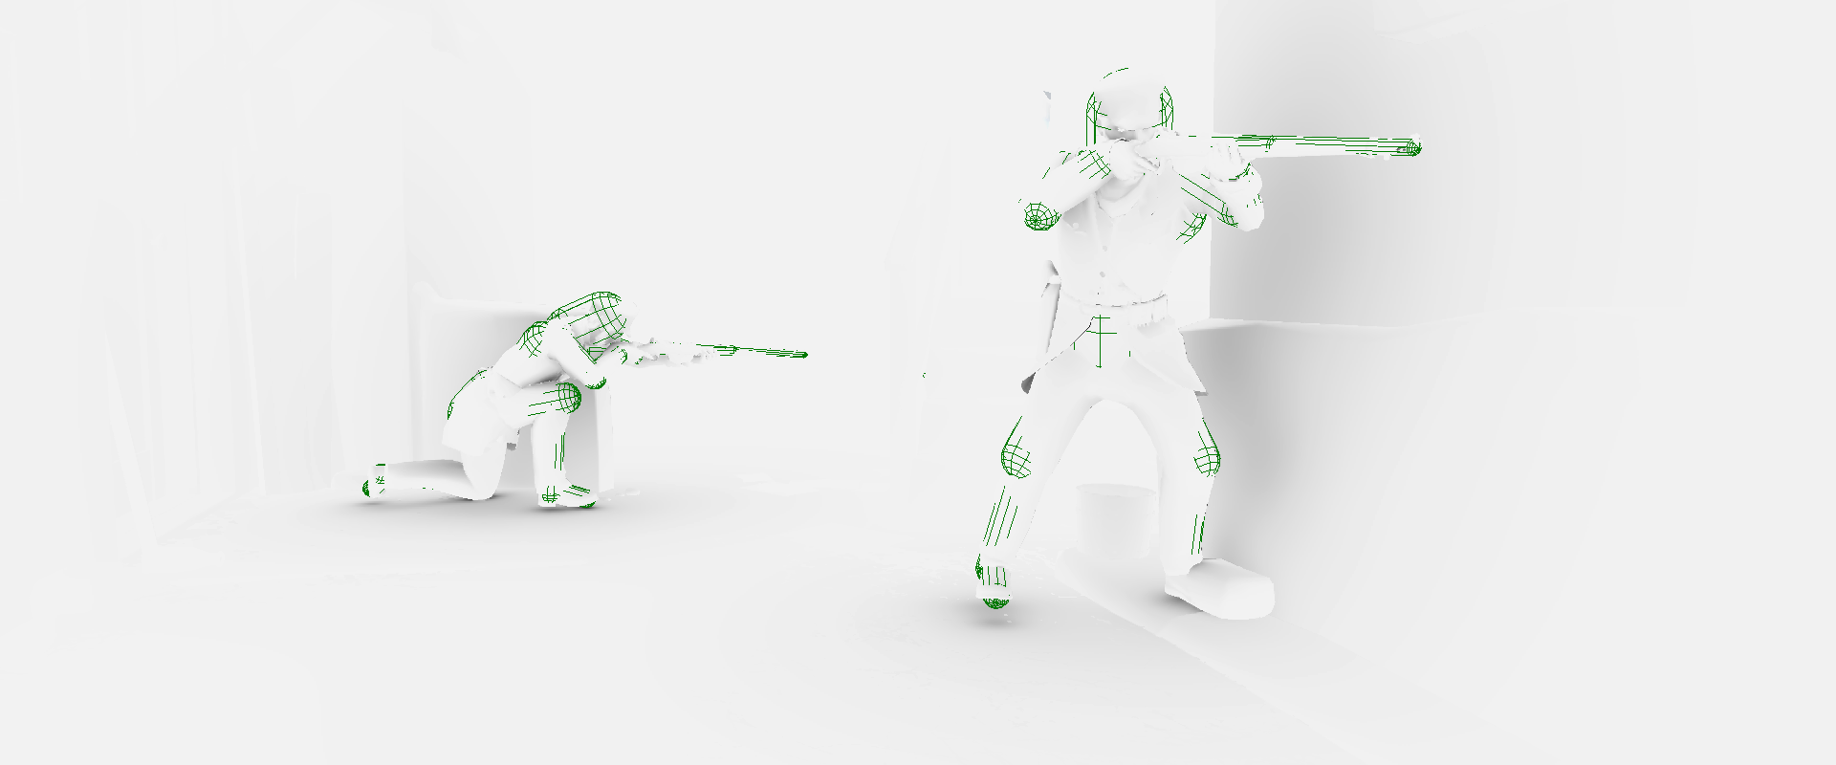
Ambient Occlusion
Dynamic AO from capsules skinned to characters
Notes:
To get occlusion from dynamic characters and objects, we compute analytical occlusion values from capsules that are skinned to joints. This was inspired by Stephen Hill’s presentation on Splinter Cell: Conviction, and is also similar to what Naughty Dog recently presented for the Last of Us. The occlusion factor is calculated using the technique on Iñigo Quilez’s website for calculating the AO factor from a sphere. http://www.iquilezles.org/www/articles/sphereao/sphereao.htm.
The upside over SSAO is that you get soft, stable occlusion with a really nice falloff. This helps avoid the “crease shader” look that you usually get from SSAO, and also lets you avoid the noise or banding artifacts. To get the same wide falloff with SSAO you would need a really large sampling pattern.
Originally we handled the volumes the same way we handled lights, where we binned per tile and then computed the occlusion during the forward rendering pass. This works and gave nice results, but was ultimately too expensive. So we ended up doing the AO in a half-res deferred pass, using a compute shader to bin the volumes and then calculate the AO factor. With this setup we typically spend between 1 and 2ms GPU time on the PS4, with over 100 volumes on-screen during the more busy parts of the game.

Slide 23
AO Capsules Off
Notes:
This is a screenshot of a recent build running on PS4, with the AO capsules off.

Slide 24
AO Capsules On
Notes:
Now with them enabled.

Slide 25
Core Shading Model
Default specular BRDF is Cook-Torrance
D term is GGX distribution from Walter et al.
Matching Smith G term derived in same paper
Schlick’s approximation for Fresnel
Lambertian diffuse, balanced with specular intensity
Notes:
Now we’re going to dive into some technical details about our shading model. Our default specular model is a Cook-Torrance microfacet BRDF. We’ve been using some form of Cook-Torrance for nearly 3 years now. For our distribution term we’re using the GGX distribution described in Walter’s paper from 2007. We’re also using the matching Smith geometry term derived in the same paper, which is specifically formulated to ensure that the BRDF is normalized. As for the diffuse, we’re currently using standard Lambertian diffuse. To balance it with our specular model, we multiply it with the inverse of the specular intensity.

Slide 26
Core Shading Model
GGX + Cook Torrance == Lots of math
But we have lots of ALU!
Can be optimized
Don’t use trig
Fold Smith G term into denominator
See our course notes from SIGGRAPH
Have artists work with sqrt(roughness)
More intuitive, better for blending
Notes:
BRDF’s in academic papers are always written in terms of trig functions. You can pretty much always optimize that away by exploiting the fact that A dot B == cos(theta) (assuming A and B are normalized, of course) and by then applying some substitutions. And then you can also apply some additional algebraic simplifications to optimize things even further. You can see our course notes from our SIGGRAPH talks if want the full details.
[0-1] roughness can be a little hard to work with. It feels very “non-linear”, and you end up with many of your values in the [0-0.1] range. If you instead have artists specify sqrt(roughness) and then square it in the shader, you get a much better distribution of values. This is also important for blending roughness values from parameter maps.

Slide 27
// Helper for computing the GGX visibility term
float GGX_V1(in float m2, in float nDotX) {
return 1.0f / (nDotX + sqrt(m2 + (1 - m2) * nDotX * nDotX));
}
// Computes the specular term using a GGX microfacet distribution. m is roughness, n is the surface normal, h is the
// half vector, and l is the direction to the light source
float GGX_Specular(in float m, in float3 n, in float3 h, in float3 v, in float3 l) {
float nDotH = saturate(dot(n, h));
float nDotL = saturate(dot(n, l));
float nDotV = saturate(dot(n, v));
float nDotH2 = nDotH * nDotH;
float m2 = m * m;
// Calculate the distribution term
float d = m2 / (Pi * pow(nDotH * nDotH * (m2 - 1) + 1, 2.0f));
// Calculate the matching visibility term
float v1i = GGX_V1(m2, nDotL);
float v1o = GGX_V1(m2, nDotV);
float vis = v1i * v1o;
// Multiply this result with the Fresnel term
return d * vis;
}
Notes:
Here’s some code showing a more game-ready form of GGX

Slide 28
Core Shading Model
Other BRDFs available
Beckmann (also taken from Walter et al.)
Anisotropic GGX
Hair (Kajiya-Kay)
Skin (pre-integrated diffuse)
Cloth

Slide 29
Notes:
Here is a screenshot showing our skin shading model being used on one of our principle characters. You can see the scattering pretty clearly on the nose and cheeks

Slide 30
Skin
Our most expensive shader!
Texture lookup per light based on N dot L
Multiple specular lobes
Didn’t use shader gradient-based curvature
Too many artifacts
Used curvature maps instead
Notes:
It’s expensive! You get a texture lookup per light, plus we use multiple specular lobes.
We didn’t end up using the automatic curvature calculation proposed by Eric Penner, since got too many artifacts. We just had the artists bake curvature maps instead.

Slide 31
Skin
Pre-integrated skin diffuse with SH
Notes:
One issue we had to tackle with our skin shading was using our pre-integrated diffuse scattering term with our spherical harmonics lighting probes. Fortunately this is pretty simple to do with SH if you already know how to compute standard diffuse irradiance. With SH you can convolve a radially-symmetrical kernel with a lighting environment using a simple dot product, and for standard diffuse you use a clamped cosine as a kernel. All you need to do this is a representation of your kernel as zonal harmonics, so we compute that by numerically integrating the diffuse scattering function with the zonal harmonics basis functions. We then store those ZH coefficients in a lookup texture parameterized by surface curvature, and at runtime we sample the appropriate coefficients and use them to perform the dot product with the lighting environment stored in the probe.

Slide 32
Ambient Skin (Diffuse only)
Left is using normal SH lighting convolved with cosine kernel
Right is using SH lighting convolved with the scattering kernel
Notes:
Here’s a comparison image that shows a character being lit only by a diffuse SH probe, with no specular. The left image is using a standard cosine kernel, and as you can see the skin looks unnaturally hard due to the lack of subsurface scattering. On the right we use the pre-integrated diffuse coefficients, and as you can see the result is much more natural.

Slide 33
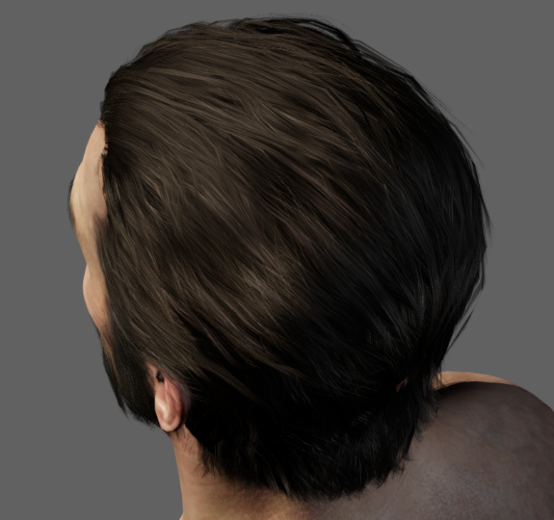
Hair Shading
Not physically-based ☹
Kajiya-Kay
Haven’t had time to investigate real-time Marschner
Tweaked Fresnel curve
SH diffuse using tangent direction
Analytic Tangent Irradiance Environment Maps for Anisotropic Surfaces[Mehta 2012]
Notes:
This is one weak spot in our shading model. Unfortunately I haven’t had the time properly develop something more robust. Fortunately our artists are awesome, and they’ve achieved good results.

Slide 34
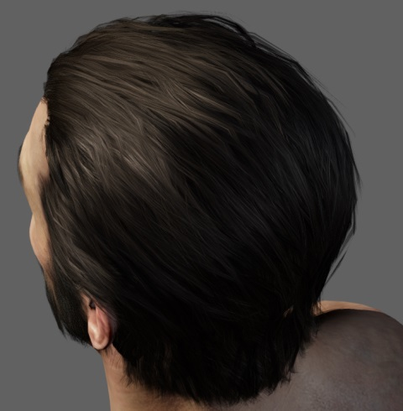
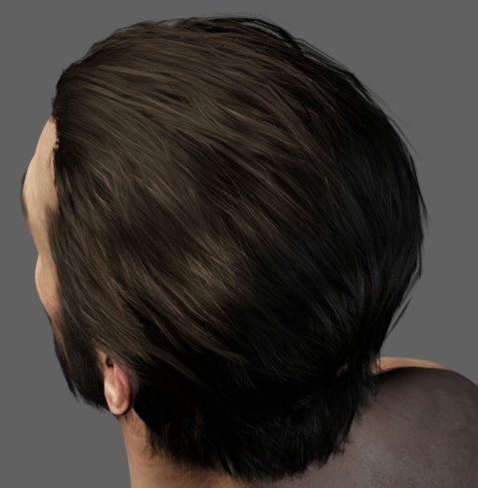
Hair Shading
Secondary specular lobe
Shifted along tangent towards tips
Takes albedo color
Notes:
Image on the left has no secondary spec, image on the right has secondary spec turned on.
It’s probably hard to see, but the secondary specular lobe takes on more of the albedo color compared to the primary specular lobe. This is basically a poor man’s approximation of the multiple specular lobes from Marschner.

Slide 35
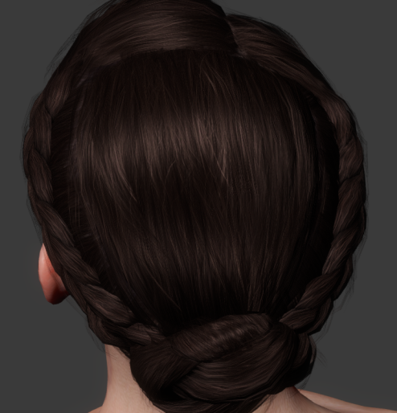
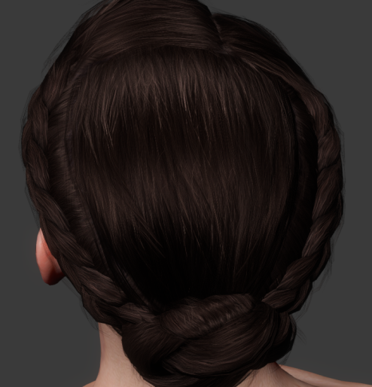
Hair Shading
Shift maps to break up highlights
Additional shift along tangent direction
Notes:
Shift maps help break up the highlights, which prevents the surface from looking to flat and unnatural.

Slide 36
Hair Shading
Flow maps to define tangent direction
Authored in Mari
Notes:
Flow maps are exactly like normal maps, except instead of giving you a new normal (z-basis) they give you a new tangent (x-basis). They’re stored in vertex tangent space, but Mari lets you just intuitively paint directions on the mesh and it remaps it for you. In the case of hair they paint the actual combing direction of the hair itself.

Slide 37
Notes:
Next up, I’m going to talk a bit about our cloth shading.

Slide 38
Cloth Shading
Observations from photo reference:
Soft specular lobe with large smooth falloffs
Fuzz on the rim from asperity scattering
Low specular contribution at front facing angles
Some fabrics have two toned specular colors
Notes:
When we were developing our cloth shader, we took some high-resolution photos of some real-world material samples in order to observe the key properties of those fabrics. On the right you see photograph of velvet wrapped around a cylinder, with the camera and light both placed at the same angle. The most noticeable aspect is the strong grazing specular on the edge of the cloth, which is due to asperity scattering through fibers that point away from the surface. For the front-facing areas there’s actually very little specular contribution, which is shows that the specular response is actually backwards compared to a typical microfacet BRDF. In fact to the right of velvet we have a rendering of a cylinder under the same lighting conditions using a Cook-Torrance BRDF with roughness of 1.0, and as you can see the reflectance is highest at the center and falls off towards the edges.

Slide 39
Cloth Shading
Inverted Gaussian for asperity scattering
Translation from origin to give more specular at front facing angles
No geometry term
Notes:
We ended up implementing a BRDF based on Michael Ashikhmin’s work that was presented in his paper entitled “Distribution-based BRDF’s” from 2007. The distribution term is an inverted Gaussian, which gives us the grazing specular response observed in the photo reference. We also offset the curve a bit in order to provide a soft specular at front-facing angles. Initially we attempted to use a Smith geometry term, however the results weren’t very encouraging. Ultimately we decided that it didn’t make sense to have a microfacet geometry term for a material like velvet, where the material is composed of translucent fibers that are perpendicular to the surface. This follows Ashikhmin’s results, who felt that a geometry term wasn’t necessary and fit his distribution to measured without using one.

Slide 40
Specular Aliasing
+
=
Notes:
Now we’re going to talk a bit about specular aliasing. I’m sure most of you by now are familiar with the issue outlined on the slide, which is that physically-based specular models combined with high-frequency normal maps makes for some very sad developers. Fortunately there has been some good research in this area, and we have some options for mitigating this issue.

Slide 41
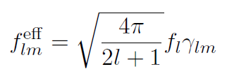
Specular Aliasing
Modify roughness maps to reduce aliasing
Using technique based on “Frequency Domain Normal Map Filtering” by Han et al.
Notes:
To remedy the issue in our own engine, we followed an approach similar to what Stephen Hill and Stephen McAuley presented last year at SIGGRAPH. Almost all of our materials use roughness maps that are auto-generated by content build pipeline, which is due to the compositing system that we’re going to talk about in a bit. This gives as an opportunity to modify the roughness values stored in the lower-resolution mip levels in such a way as to reduce aliasing. This gives us improved visuals with no additional storage or runtime cost. However instead of adjusting our roughness values by pre-baking Toksvig or CLEAN, we came up with a different approach based on “Frequency Domain Normal Map Filtering” by Han et al. The basic concept behind this paper is that you can convolve a BRDF with a normal distribution function in order to produce an effective BRDF that considers all normal within that NDF. So if you can represent all normal map texels within the footprint of a given pixel as and NDF and then convolve it, you’ll get the correct, antialiased result for that pixel. Of convolutions in the spatial domain are expensive, so Han utilized spherical harmonics to perform the convolution in the frequency domain. With spherical harmonics the convolution of a function with a radially symmetric kernel can be achieved with a simple dot product, which was demonstrated Ravi Ramamoorthi back in 2001.

Slide 42
Specular Aliasing
Represent NDF as spherical Gaussian (vMF distribution)
Approximate BRDF in SH as a Gaussian
Convolution of two Gaussians is a new Gaussian
Use relationship to compute new roughness
BRDF
NDF
New Roughness
Notes:
Working purely in spherical harmonics isn’t a practical option for specular BRDF’s, since a prohibitive number of coefficients would be required to avoid attenuation of higher frequencies. Instead, Han represented NDF’s using the von-Mises Distribution which is basically a normalized Gaussian distribution located on the surface of a sphere. If we also approximate a specular BRDF as a Gaussian, we can then convolve the two Gaussians in the frequency domain to determine compute a new Gaussian representing the effective BRDF. By relating these new Gaussian with old Gaussian we can actually represent the effective BRDF as a modification of the roughness value, which is how we compute the modified roughness that we store in our roughness maps. This conceptually similar to what Michael Toksvig proposed in his technical report.

Slide 43
No AA
Ours
Ground Truth
Notes:
Here’s a quick comparison of how our technique looks when used with our shading model. The images show a flat plane lit by two point lights, with a high-frequency normal map that is being minified by the texture filtering hardware. The leftmost image has no specular antialiasing, the middle shows our method, and the rightmost image uses mipmapped texture-space lighting. It may be difficult to see on the slide, but our technique significantly reduces aliasing and compares well to the ground truth render. We have more comparison images in our course notes if you’re interested, or better yet you can download the sample code and see the results in motion.

Slide 44
Notes:
Needed a fast solution for bringing in high quality detail maps into the engine quickly. Initially, we looked into off the shelf solutions but we found most laser scanning methods to be too noisy and not high enough resolution. We developed a material scanner in-house based on photometric stereo techniques to capture the high fidelity normal detail.

Slide 45
Scanning
Notes:
The scanner has a custom built light controller hooked up to the PC. The PC controls the lights and the camera to take pictures in unison. The pictures are stored on the PC and the normal/albedo solver is run after all 10 pictures from the 10 different lights have been collected.

Slide 46
Scanning
Notes:
Lighting from the 10 different directions. The last two are the albedo and normal map. The albedo has all the lighting removed from it.

Slide 47
Scanning
Notes:
A scanned texture rendered in Maya

Slide 48
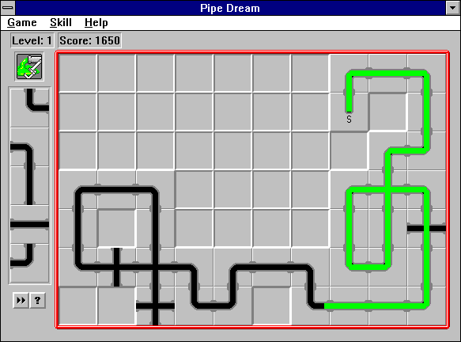
Material Pipeline
Notes:
Let’s talk about materials

Slide 49
Material Pipeline
Materials = text assets
Uses our custom data language (radattr)
Language supports:
Types
Inheritance
UI layouts
Metadata
:bumpy_material := ( opaquematerial
:enable_diffuse_ = true
:enable_specular_ = true
:specular_map = ( :name = "bumpy_material_spc" )
:normal_map = ( :name = "bumpy_material_nml" )
:specular_intensity = 0.05
:specular_roughness = 0.1
)
:bumpy_material_red := ( bumpymaterial
:albedo_tint_color = ( Color
:r = 1.0
:g = 0.0
:b = 0.0
)
)
Notes:
We have a custom data language that we call radattr, and we use it for most of our assets. What’s cool is that it has inheritance, which essentially lets us come up with “base” assets and then derive from them to create new assets. The new assets can then override select values, which is an easy way to create variations of the same material. Then if a change is made in the base material, it propagates all the way through to the children.
Our custom language has some nice features, but we’ve had to spend a lot of time developing it, optimizing it, and fixing the bugs that come up. If we did it again, we would probably use an existing language.

Slide 50
Material Pipeline
Material authoring is feature-based
No shader trees
Material editor tool for real-time editing
Can also be hosted inside of Maya

Slide 51
Material Pipeline
Notes:
This is the stand-alone version of the material editor

Slide 52
Material Pipeline
radattr inheritance used to make templates
Common parameters shared in base material
Derived material only stores changes from base
Quicker asset creation
Global changes can be made in a single asset

Slide 66
Shaders
Hand-written ubershaders
Lots of #if’s
Major material features = macro definitions
Parameters (spec intensity, roughness, etc.) hard-coded into the shader, except when animated or composited
Some code is auto-generated to handle textures and animated parameters
Notes:
Materials reference files containing shader code. Then when we build a material, we pull in the source code and append some new code specific for the material. This code contains hard-coded constants for material parameters, texture and sampler definitions, constant buffers for animated properties, and some code that’s used to help route textures to whatever material feature is using them.

Slide 67
Shaders
Pre-defined “permutations”
Permutation = macro definition + entry point
Permutations for skinning, blend shapes, instancing, light maps, etc.
Debug permutation for visualization/debugging
Shaders compiled in build pipeline based on permutation + material
Notes:
The build pipeline goes through all meshes, and figures out which permutation or permutations will be needed based on the context. The build pipeline then kicks off a compilation of the required shaders using both the permutation and the assigned material.

Slide 68
Shaders
Material Asset
Processed Shader Code
Shader Set
Compile Shader Set
Built Shader Set
Build Material
Built Material
Shader Code
Level Asset
Build Level
Built Level
Notes:
This is a simplified, there’s actual quite a few intermediate steps that aren’t depicted here. However it gives you an overall feel for how shaders are processed in our build pipeline.

Slide 69
Shaders
Pros:
Shaders are optimized for a material
Optimizer has full access
No runtime compiling for the game itself (used by tools)
Cons:
Lots of shaders to compile!
We cache everything, but iteration can be slow
Monolithic shaders are hard to debug
Lean heavily on the compiler

Slide 71
Material Compositing
Mostly offline process
Material asset specifies composite “stack”
Each layer in the stack has:
Referenced material
Blend mask
Blending parameters
Recursively build + composite referenced materials
Combine each layer 1 by 1 using pixel shader

Slide 72
Material Compositing
Generates parameter maps from materials and blending maps
Support compositing subset of BRDFs
Cloth, GGX, and Anisotropic
Compositing cloth requires applying 2 BRDFs
Notes:
Compositing is an offline process for generating parameter maps for materials, none of it is performed at runtime. Essentially in our material editor we allow for a “stack” of composited materials, similar to a series of layers in Photoshop. The material parameters from those layers are then used to generate texture maps containing parameter values. The parameter values can come from textures in the source materials, or from parameters defined in the material asset file. The blending of parameters is controlled by blend masks provided for each layer in the stack, as well as a few other controls. Everything could really be done in Photoshop if you wanted to, but it would be much more cumbersome.
We also support compositing materials with different BRDFs, but only for a subset of our BRDFs. Anisotropic and GGX are similar since they’re essentially the same BRDF, but cloth was more tricky. Currently for cloth compositing we compute lighting twice, once with the cloth BRDF and again with GGX, and then blend the results using a blending map generated by the compositing pipeline.

Slide 73
Material Compositing
Map | R Channel | G Channel | B Channel | A Channel | Format
1 | Normals X | Normals Y | N/A | N/A | BC5
2 | Diffuse R | Diffuse G | Diffuse B | Alpha (Optional) | BC1 or BC3
3 | Specular R | Specular G | Specular B | Specular Intensity | BC3
4 | Roughness | AO | BRDF Blend | Anisotropy | BC3
Notes:
These are the texture maps output by our compositing pipeline. Other parameters supported by our material model, such as RGB opacity, can be specified in the material itself but will not be composited using the blend maps.

Slide 74
Material Compositing
// Compositing pixel shader run on a quad covering the entire output texture
CompositeOutput CompositePS(in float2 UV : UV) {
CompositeOutput output;
float blendAmt = BlendScale * BlendMap.Sample(Sampler, UV);
float4 diffuseA = DiffuseTintA * DiffuseMapA.Sample(Sampler, UV);
float4 diffuseB = DiffuseTintB * DiffuseMapB.Sample(Sampler, UV);
float diffuseBlendAmt = blendAmt * DiffuseContribution;
output.Diffuse = Blend(diffuseA, diffuseB, diffuseBlendAmt,
DiffuseBlendMode);
// Do the same for specular, normals, AO, etc.
return output;
}
Notes:
This is a simplified version of the shader that we use to generate composited parameter maps. It’s pretty simple: it just pulls in textures and material parameter values, and combines with the values from the next material in the composite stack.

Slide 75
Notes:
Here’s an in-game prop with one set of composites

Slide 76
Notes:
Here’s the same prop with a different set of composites, giving it a different look.

Slide 77
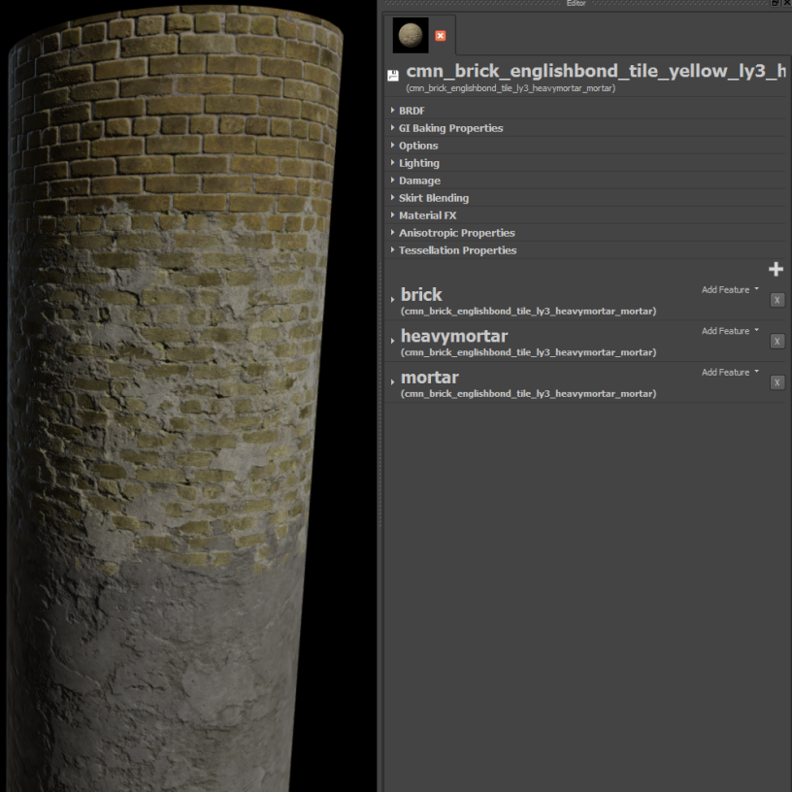
Material Layers
Up to 4 layers
Derived from base materials
Separate compositing chain per layer
Driven by vertex colors
Notes:
Our materials also support a runtime layer-blending system. We support up to 4 layers per material, and each layer has full inheritance and compositing support. Typically an artist will derive a layer from a base material asset, which allows them to quickly assemble multi-layered materials from completely unique material assets. The contribution of each layer is primarily driven by dedicated vertex color channel, which is used in conjunction with blend maps and height maps to determine the final alpha value. In certain cases we also blend in layers based on runtime-generated maps. One notable example of this is our a damage system, which uses accumulated bullet decals to gradually reveal an underlying layer on environment materials.
On the right is a screenshot of a multi-layer material being edited

Slide 78
Material Layers
Notes:
Here’s a shot of a production level taken in the Maya renderer, making use of layer blending

Slide 79
Material Layers
Notes:
This is a visualization of the layer blend weights that are painted into a vertex color set

Slide 80
Material Layers
Notes:
This is a visualization of the number of layers per material. Most of them are 3, some are 1.

Slide 81
Material Layers
LayerParams combinedParams;
[unroll]
for(uint i = 0; i < NumLayers; ++i) {
// Build all layer params from textures and hard-coded
// material parameters
LayerParams layerParams = GetLayerParams(i, MatParams, Textures);
// Blend with the previous layer using vertex data and blend masks
combinedParams = BlendLayer(combinedParams, layerParams, vtxData,
BlendMode, Textures);
}
// Calculate all lighting using the blended params
return ComputeLighting(combinedParams);
Notes:
Heavily simplified, real code is more complicated. But this is general idea.

Slide 82
Notes:
This is a screenshot taken on PS4 of our game running in a test atrium level.

Slide 83
Notes:
Baked lighting from lightmaps and irradiance probes

Slide 84
Notes:
Ambient specular from cubemaps

Slide 85
Notes:
Dynamic lighting from the sun

Slide 86
Notes:
Albedo only (AKA Quake 1 mode)

Slide 87
Notes:
Baked reflection occlusion

Slide 88
Notes:
Dynamic AO capsules

Slide 89
Notes:
Final image again

Slide 90
Notes:
Another shot from a production level

Slide 91
Notes:
Baked diffuse only

Slide 92
Notes:
Baked specular

Slide 93
Notes:
Dynamic lights

Slide 94
Notes:
Albedo

Slide 95
Notes:
Directional occlusion
Unfortunately the player’s costume + weapons had some changes, and the occlusion map was not re-baked. This is why he’s all white.

Slide 96
Notes:
This is a mode showing the number of lights that intersect each 16x16 tile. It basically tells you how expensive the lighting will be. Green is good, blue is okay, red is bad, and white means that we won’t ship.

Slide 97
Notes:
Dynamic AO volumes

Slide 98
Notes:
Final image again

Slide 99
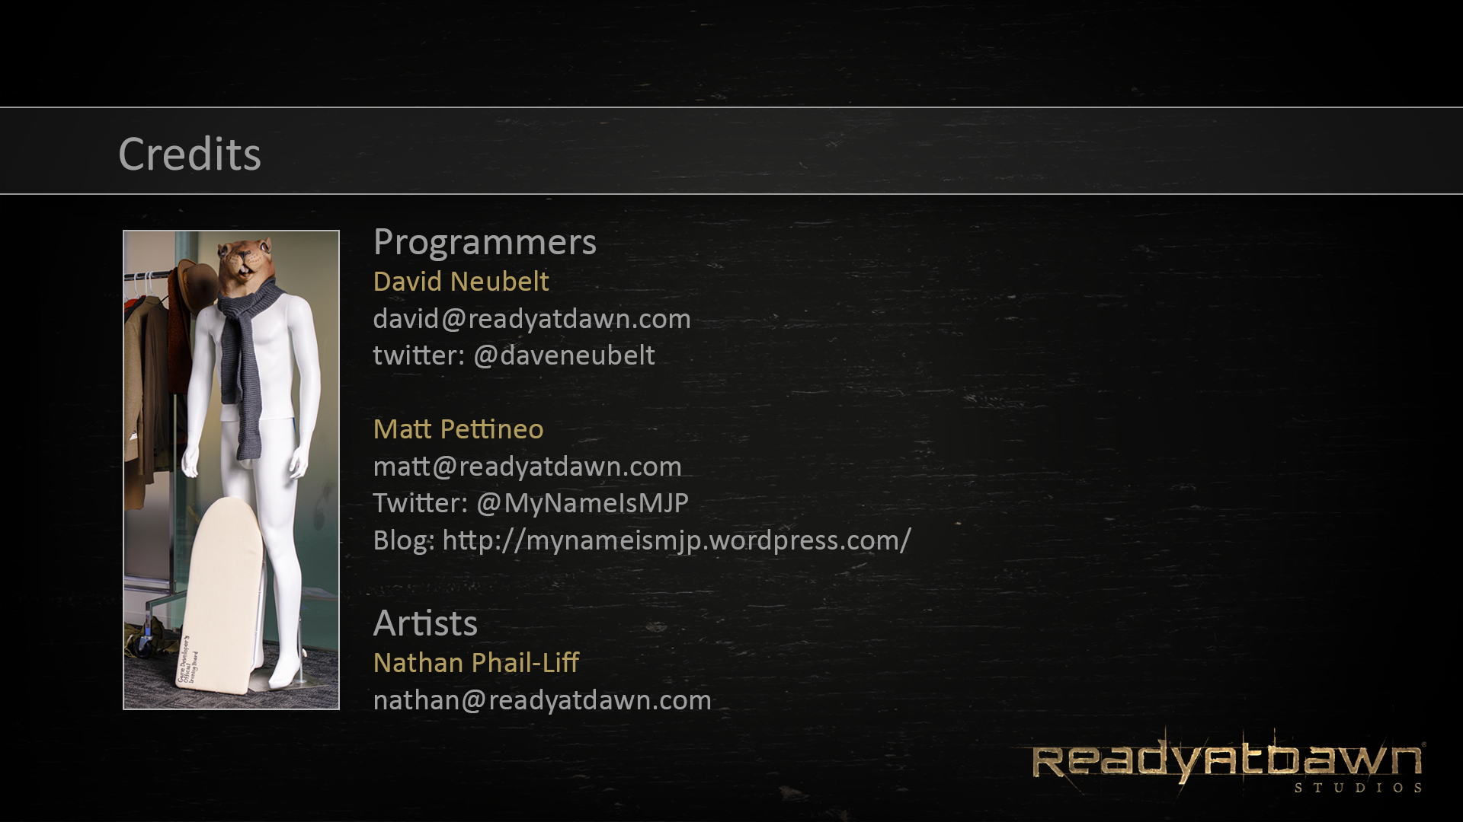
Garret Foster
garret@readyatdawn.com

Slide 100
Questions?
Notes:
Our tech director Garret Foster while on a phone interview

